Slide 1
PAPER 1 Comparison of machine learning techniques used in type II diabetes risk prediction
By
kaluarachchi K.N., Premachandra K.P., Dissanayake R.B.N.

Slide 2
Objective
Compare Eight (8) Supervised Machine Learning models to identify the best algorithm with a low bias-variance trade-off for the diagnosis of Type II diabetes among female Native Americans living in America (PIMA)
Machine Learning models developed
Logistic Regression
Decision Tree
Random Forest
Support Vector Machine (SVM)
K-Nearest Neighbor (KNN)
Naïve Bayes
Gradient Boosting
Artificial Neural Network (ANN)
Data used
Native Americans living in Arizona (PIMA) Indians Diabetes Dataset, published by National Institute of Diabetes, Digestive & Kidney Diseases in the USA.

Slide 3
Basis on which the ML models were evaluated & compared (Indicators)
Testing Accuracy
Mean Square Error (MSE)
Precision
Rate of Recall (Sensitivity)
F1-score
Dataset and partitioning
768
Patient records
430
Training
Data
338
Testing
Data

Slide 4
Results
Random Forest (RF) has the highest Testing Accuracy – 83.12% & lowest MSE.
ANN achieved the highest MSE.
The results also shows that the most significant predictor variables are;
Number of pregnancies.
Insulin level
BMI level
Age
Conclusion
The RF with 50 subtrees is the most accurate ML model that can be used to diagnose Type II diabetes in the PIMA Indian Diabetes Dataset.

Slide 5
Paper 2 Comparative Research on Diabetes Influencing Factors Based on Random Forest and Decision Tree Models
By
Liping Li

Slide 6
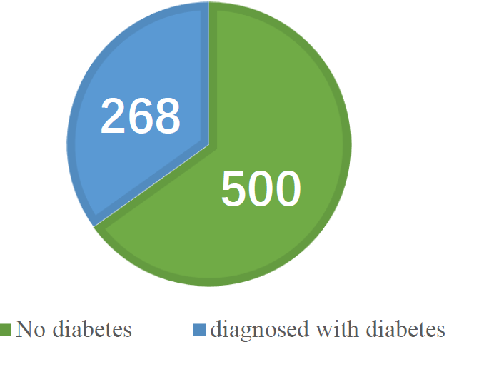
Objective
To forecast the influencing factors of Diabetes Mellitus (Type II) by comparing the results from Two (2) Machine Learning models;
Random Forest
Decision Trees
Data Source & Description
The data is derived from the PIMA Indian Dataset (PID) in the UCI dataset, which is mainly about the characteristic information of Pima Indian women over 21 years old. There are a total of 768 samples, including 9 characteristic variables, respectively 8 predictors and 1 label variable (label value 1 represents diabetes, label value 0 represents no diabetes).
According to the Target variable label value category statistics, there are 268 samples with a value of 1 (having diabetes) and 500 samples with a value of 0 (not having diabetes)
Dataset Features
Pregnancies | Blood glucose
Blood pressure | Serum insulin
Triceps skin thickness | Age
Body mass index | Diabetes pedigree function

Slide 7
Random Forest (RF) and Decision Trees (DT) were used to conduct a comparative study on the influencing factors of Diabetes with the aim to;
Enhance the performance of the forecast model
Increase the screening rate of Diabetes
Reduce the degree of the disease deterioration
Indicators evaluated
Testing Accuracy
Precision
F1-score
Rate of recall
Results
Random Forest (RF) has a higher F1-score – 79%.
Decision Trees (DT) achieved a lower F1-score – 72%.
The results also shows that the most significant predictor variables are;
Blood Glucose
Diabetes Pedigree function
BMI level
Age

Slide 8
Why Diabetes?
Of all the major non-communicable diseases to threaten human health, Diabetes ranks 3rd after Cardiovascular diseases & Cancer.
According to WHO, the costs associated with treating Diabetes are rising at an alarming rate, such that between 2005-2015, it led to an economic loss of $557.7 billion.
Diabetes comprises over 170 different types of complications.
According to International Diabetes Federation (IDF), 537 million people had diabetes in 2021, with 783 million anticipated to have it by 2045, approximately 10% of the world’s population.
China accounts for most Diabetes cases, with about 140 million, up from 90 million in the previous decade, a 56% rise.
Preventive measures and early diagnosis can help decrease this rising costs of treating Diabetes, and that is why using various methods to build models to analyze and predict this disease is of great importance.
There are a lot of previous work already done in this area using;
Logistic Regression
Naïve Bayes
Back Propagation Neural Network
Gradient Boosting
Random Forest etc.

Slide 9
Results & Discussion
Descriptive Statistics: Predictor Variables
Descriptive Statistics: Pearson Correlation Test

Slide 10
From the Pearson Correlation Test above, we see the strength of the correlation between the Target variable and the 8 predictors. We deduce that pregnancies (0.222), blood glucose (0.467), serum insulin (0.131), body mass index (0.293), diabetes pedigree function (0.174), and age (0.238) are reflecting an extremely positive correlation.
On the other hand, the correlation coefficient between Target and blood pressure, and triceps skin thickness was lower. It can be preliminarily learned that the variables of blood glucose, body mass index, age and pregnancies have more significant weights than other variables in predicting whether a sample has diabetes, and they can be recorded as influential factors that are more likely to cause the disease for prediction.
Furthermore, the correlation coefficient between variables show that age and pregnancies, are mostly correlated. Likewise serum insulin triceps skin thickness, body mass index & blood glucose, are all correlated.
Indicators evaluated
Testing Accuracy
Precision
F1-score
Rate of recall

Slide 11
Inferential Statistics: Feature weight values (Random Forest)
The feature weight of each variable illustrates how significant each variable is to the model, and the overall value is 1. It can be seen that blood glucose accounts for 24.83%, it gains the greatest weight and is crucial to the creation of models. For others; body mass index (16.13%), age (13.86%), diabetes pedigree function (12.16%) & pregnancies (8.99%).

Slide 12
Tables above represent the RF model's performance on the training set and the test set.
Rate of accuracy: The percentage of correct samples in the overall samples of the projected results.
= Number of Correct Predictions = 79.22%
Total Number of Predictions
Ratio of precision: The percentage of positive samples in the projected findings.
= True Positives = 78.96%
True Positives + False Positives
Rate of recall: The percentage of positive samples within the positive samples.
= True Positives = 79.22%
True Positives + False Negatives
F1-score is the comprehensive evaluation index of the precision ratio and recall rate, and is also the harmonic average of precision ratio and recall rate.
= 2 x Precision x Recall = 79.00%
Precision + Recall

Slide 13
Inferential Statistics: Feature weight values (Decision Tree)
The feature weight of each variable illustrates how significant each variable is to the model, and the overall value is 1. It can be seen that blood glucose accounts for 30.02%, it gains the greatest weight and is crucial to the creation of models. For others; body mass index (18.51%), age (14.77%), diabetes pedigree function (12.11%) & B.Pressure (10.24%).

Slide 14
Tables above represent the DT model's performance on the training set and the test set.
Rate of accuracy: The percentage of correct samples in the overall samples of the projected results.
= Number of Correct Predictions = 72.73%
Total Number of Predictions
Ratio of precision: The percentage of positive samples in the projected findings.
= True Positives = 72.19%
True Positives + False Positives
Rate of recall: The percentage of positive samples within the positive samples.
= True Positives = 72.73%
True Positives + False Negatives
F1-score is the comprehensive evaluation index of the precision ratio and recall rate, and is also the harmonic average of precision ratio and recall rate.
= 2 x Precision x Recall = 72.00%
Precision + Recall

Slide 15
Conclusion
PID dataset was used as the research data for this paper.
8 features, including pregnancies, blood glucose, blood pressure, triceps skin thickness, serum insulin, body mass index, diabetes pedigree function and age, were examined.
Target variable was whether diabetes was diagnosed or not.
The RF and DT algorithms were used to predict the data set, and the rate of accuracy, ratio of precision, rate of recall and F1-score ratio were utilized to analyze the model.
The results showed that the RF model was more suitable for predicting the data set, and this model had a stronger prediction ability than the DT model.
According to the analysis of influencing factors of diabetes in this dataset by RF model, the weight of four features such as blood glucose, body mass index, age and diabetes pedigree function accounted for the largest proportion.
Proposed actions
Elevated blood glucose should be focused on with timely medical examination and prevention.
Regarding Body mass index and age, obese people and elderly people should be vigilant.
Increase the awareness of diabetes prevention.
Pay attention to the balance of dietary structure and maintain good eating habits.
In general, this paper aims to provide support for the prevention and research of diabetes, and the several predictive variables.

